Slide 1
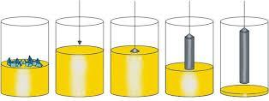
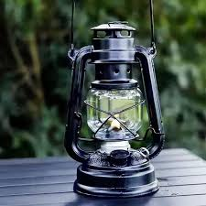
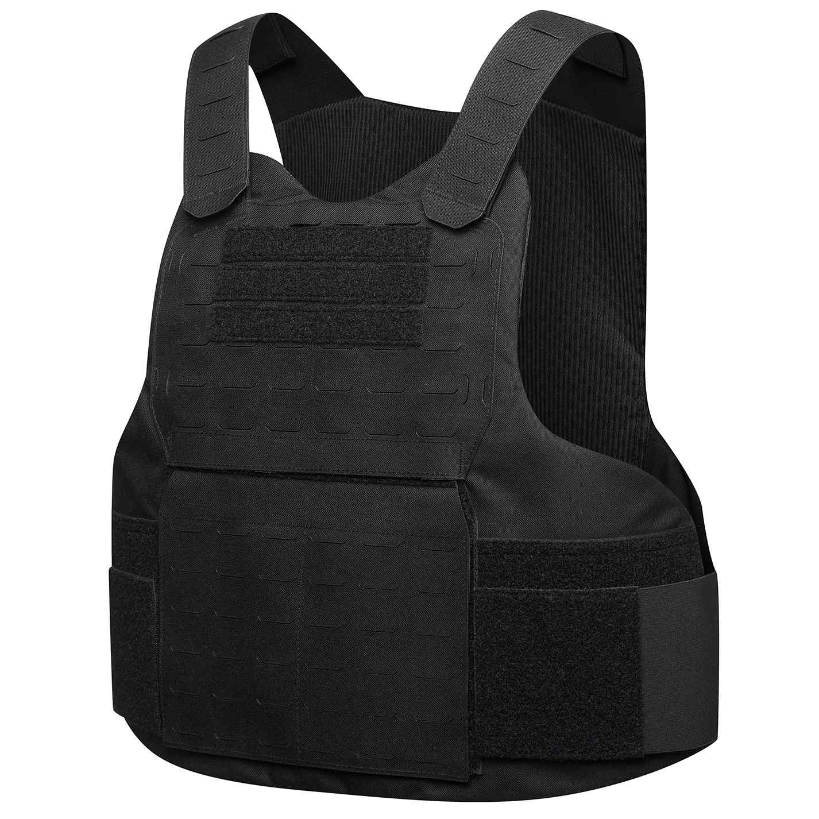
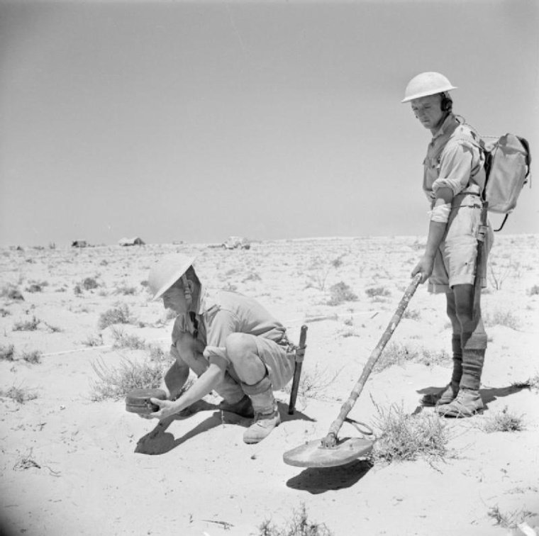
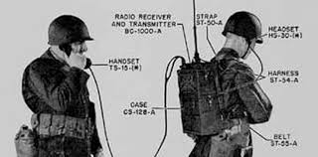
Polish Inventions
Dawid Niedźwiecki 7b

Slide 2
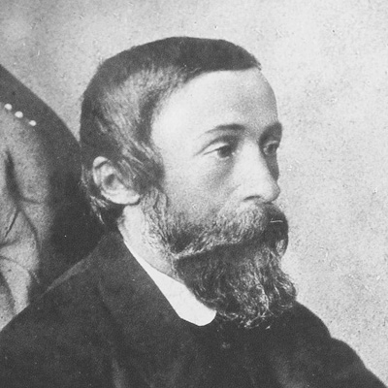
Oil Lamp
Inventor: Ignacy Łukasiewicz
Invented in March 30, 1853
It was much brighter, cheaper and safer than candles – it allowed people to work and study after dark. It was most widely used from the mid-19th century to the early 20th century. Now it’s mostly used as a decoration.
Ignacy Łukasiewicz (1822–1882)

Slide 3
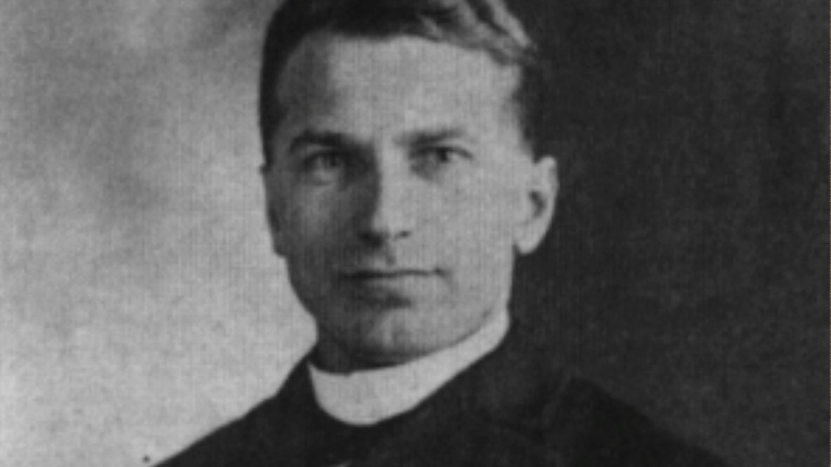
Bulletproof Vest
Inventor: Kazimierz Żegleń
Żegleń patented his "armor" in 1897, conducting tests and public demonstrations. In this armor, the energy of the projectile was absorbed by successive layers of fabric, while strength was provided by a layer of tightly woven silk threads.
Invented in 1897
Kazimierz Żegleń (1869-1910)

Slide 4
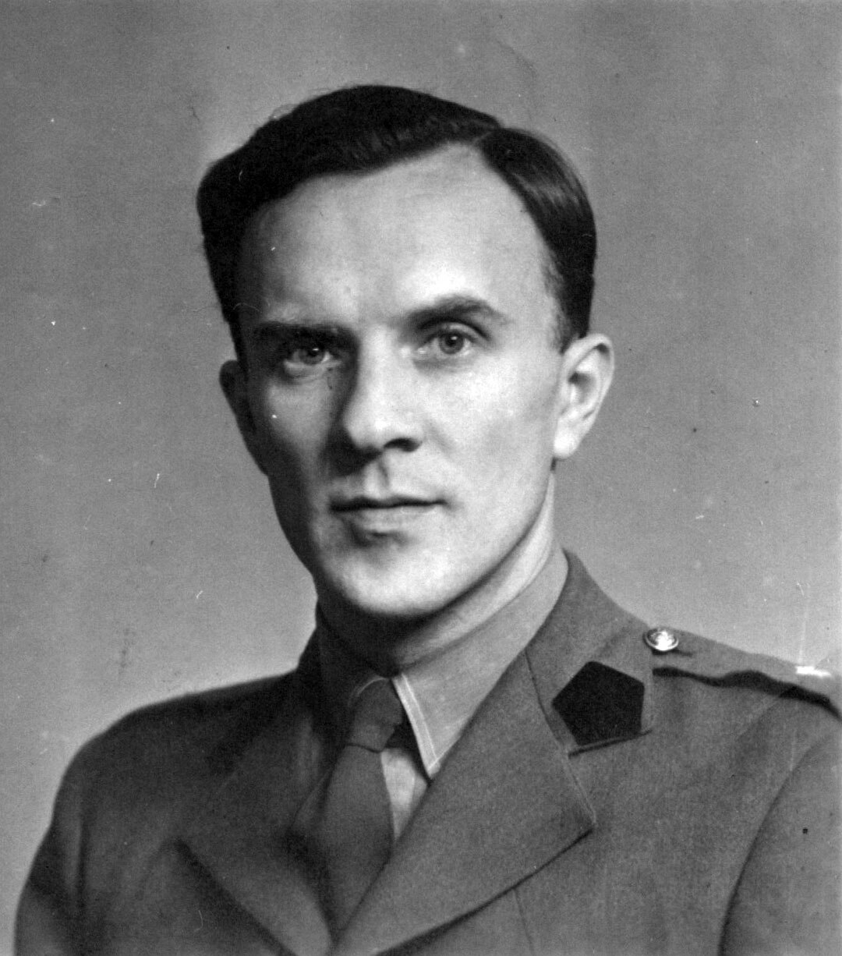
Mine Detector
Inventor: Józef Kosacki
After invention it was used by Allied sapers during World War II. Kosacki did not patent the invention so that the Allies could use it for free. It saved a lot of people.
Invented in 1941/1942
Józef Kosacki (1909-1990)

Slide 5
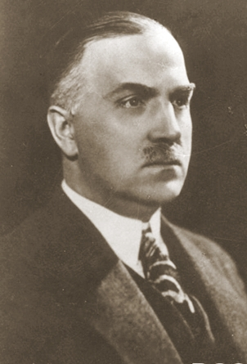
Czochralski Method
Inventor: Jan Czochralski
It was invented by accident in the laboratory. Today it is used in the production of computers, smartphones and solar panels. That is one of the most important inventions of XX century.
Jan Czochralski (1885-1953)
Invented in 1916

Slide 6
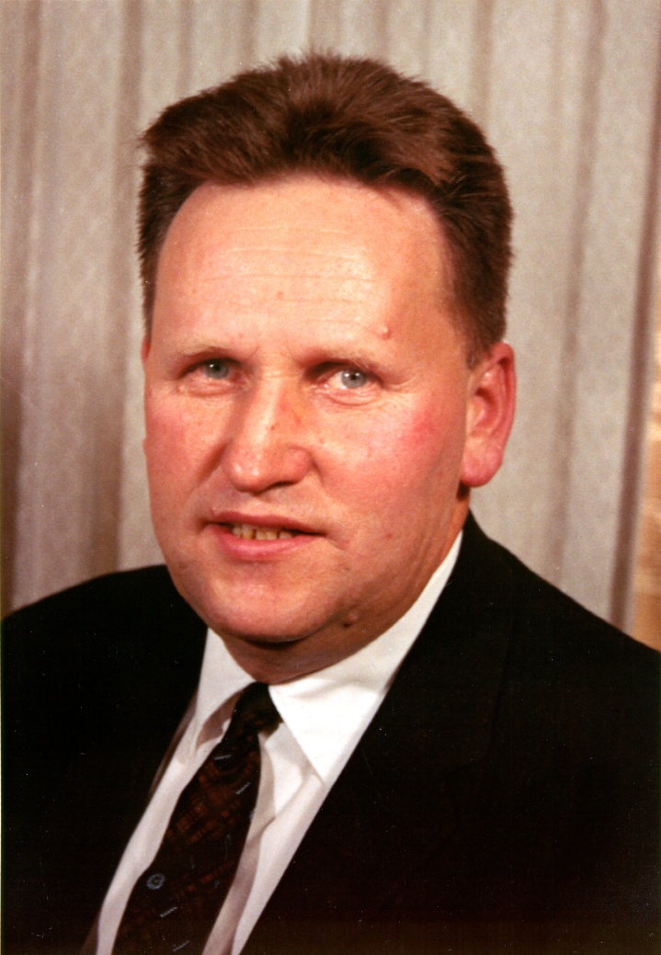
Walkie-Talkie
Inventor: Henryk Magnuski
Invented in 1937/1940
The name comes from the words walk and talk. It was used by soldiers, pilots and rescuers. The first models were the size of a backpack and weighed several kilograms.
Henryk Magnuski (1909-1978)

Slide 7

The end

