Slide 1
Polish inventors and their inventions

Slide 2
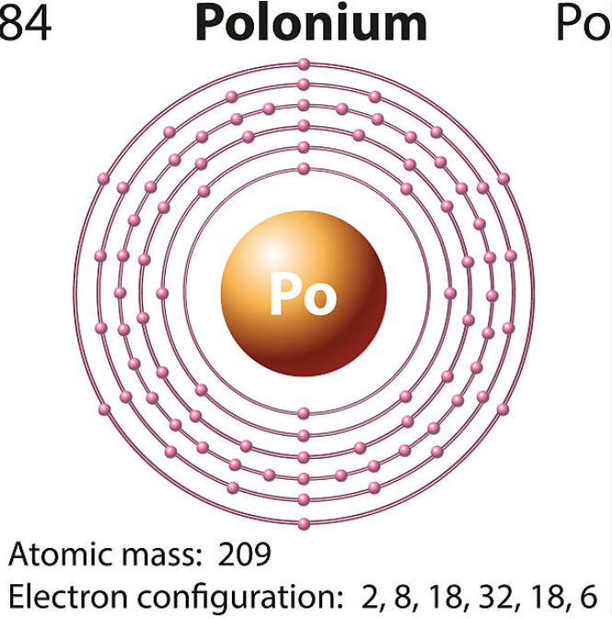
Maria Skłodowska-Curie
Maria Skłodowska-Curie was a Polish-French scientist in the fields of experimental physics and physical chemistry.
She received her first Nobel Prize in 1903 for her research on the phenomenon of radioactivity.
She received her second Nobel Prize in 1911 for the discovery of two elements – radium and polonium.
She was the only scientist to receive a Nobel Prize in two different natural sciences.

Slide 3
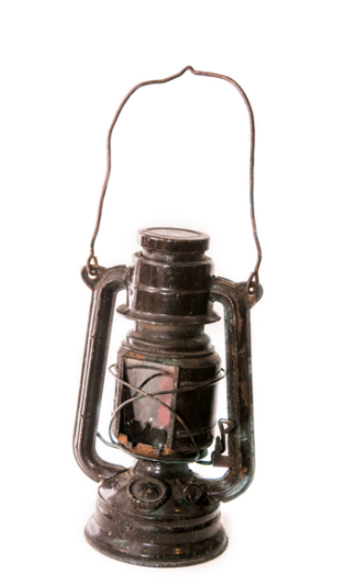
Ignacy Łukasiewicz
Ignacy was the first human to use petroleum on an industrial scale.
He is the inventor of an oil lamp.
He fought homelessness and alcoholism.
He promoted the establishment of courts, the construction of roads and bridges, schools, hospitals, etc., financing many initiatives from his own pocket.

Slide 4
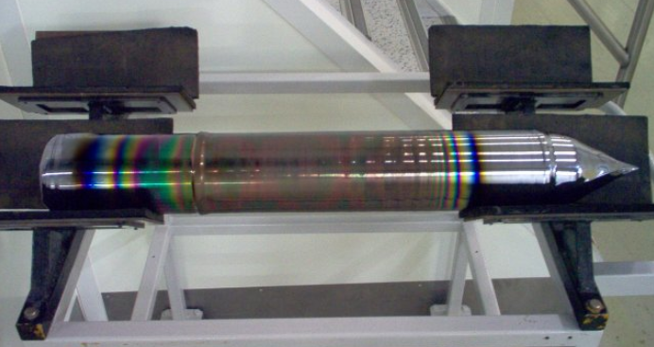
Jan Czochralski
Jan is the inventor of the commonly used method for obtaining single silicon crystals (later called the Czochralski method).
Obtaining a single crystal involves inserting a crystal seed into the melted material and then slowly and gradually withdrawing it from the melt in a way that ensures controlled and stable crystallization on its surface.

Slide 5
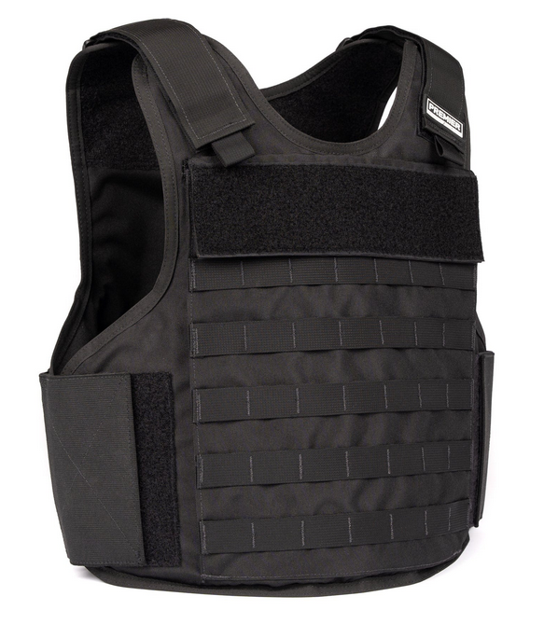
Jan Szczepanik
Jan Szczepanik is called: “Polish Edison”, “Austrian Edison”, “Leonardo Da Vinci from Galicia”, “Galician Genius”.
His most notable inventions are:
bulletproof vest
colorful movie system

Slide 6
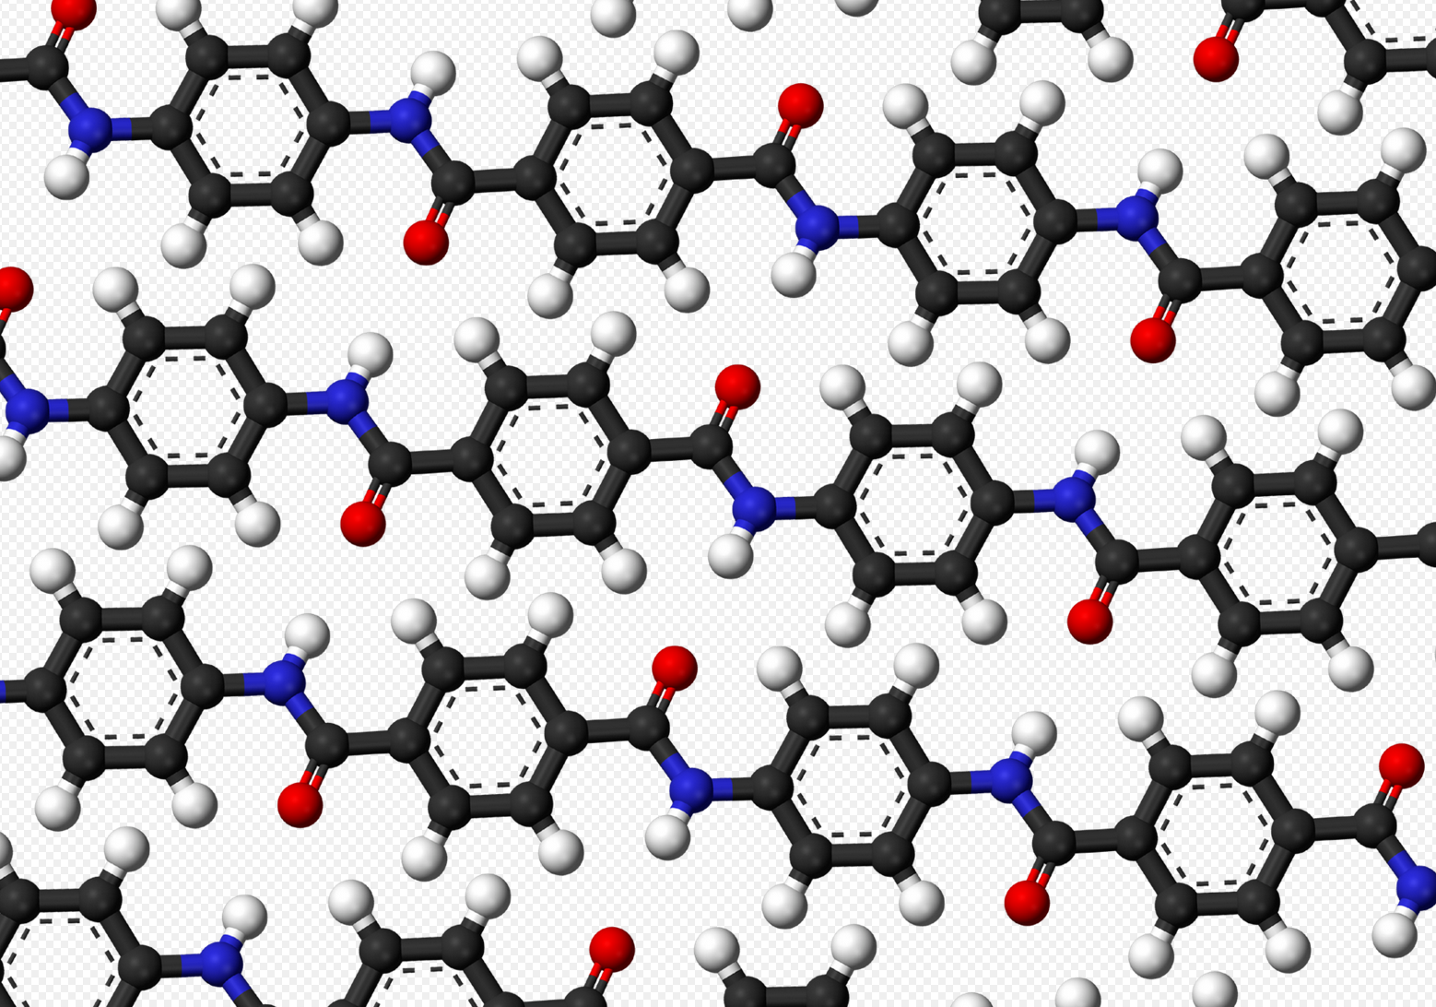
Stephanie Kwolek
Stephanie was an American of Polish descent.
She invented an ultramodern material - Kevlar.
Kevlar is used in bulletproof vests, bike helmets, safety helmets, trampolines, inside of skis, tennis rackets, kayaks, parts of the armor of aircraft carriers and fiber optic cables.

Slide 7
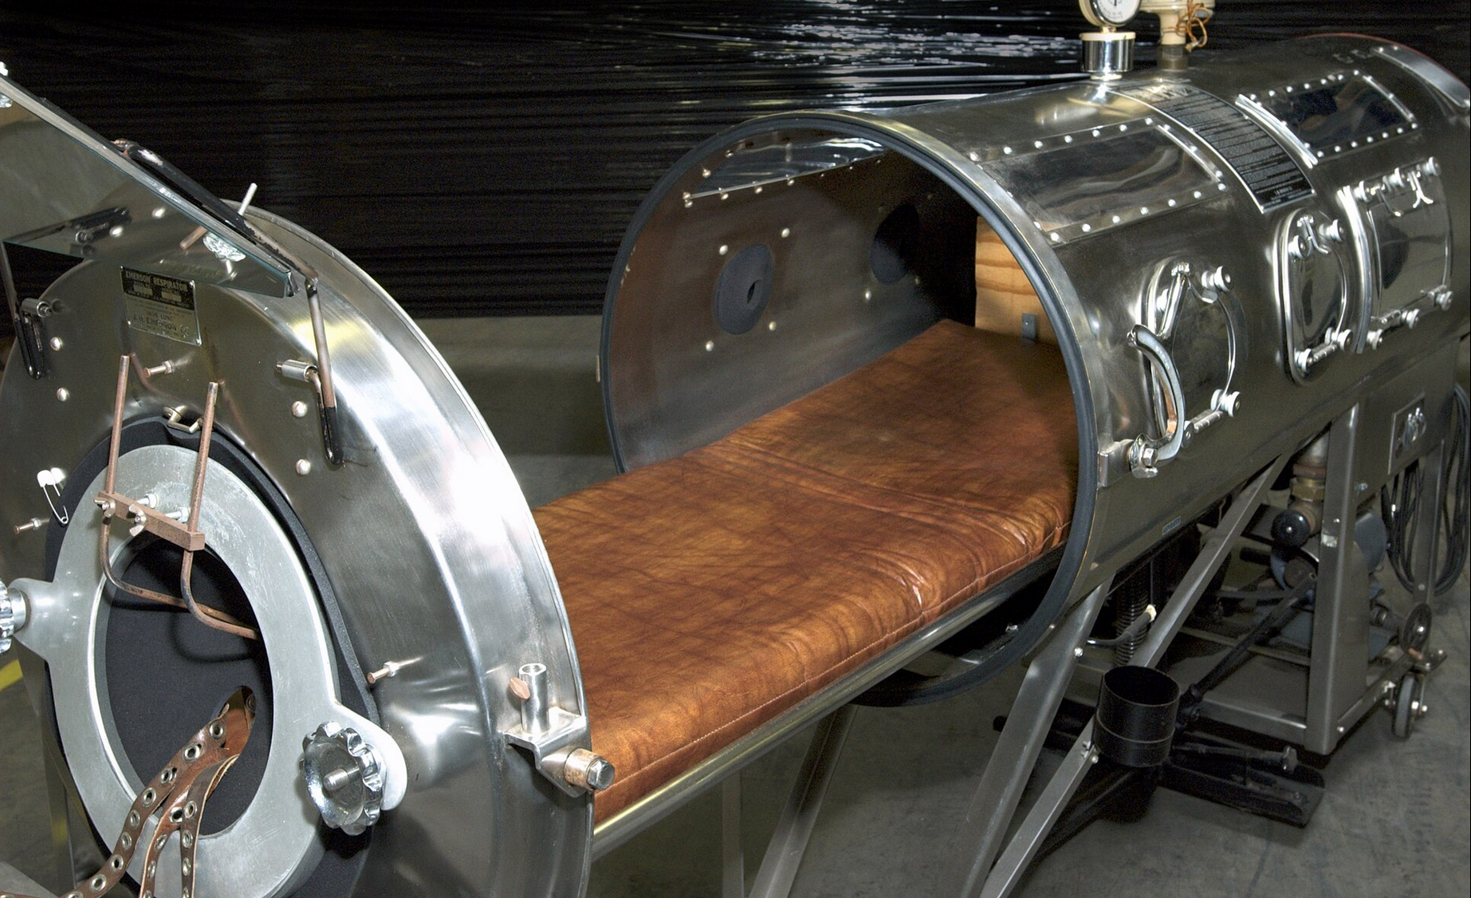
Hilary Koprowski
Hilary Koprowski was a doctor, virologist, immunologist and a university teacher.
He was the first one to discover an effective vaccine against the polio virus.
Knight of the Order of the White Eagle
(The oldest and highest state decoration of the Republic of Poland, awarded for outstanding civil and military services for the benefit of the Republic of Poland, both in times of peace and war.)
People with polio were kept in this “Iron Lung”

Slide 8
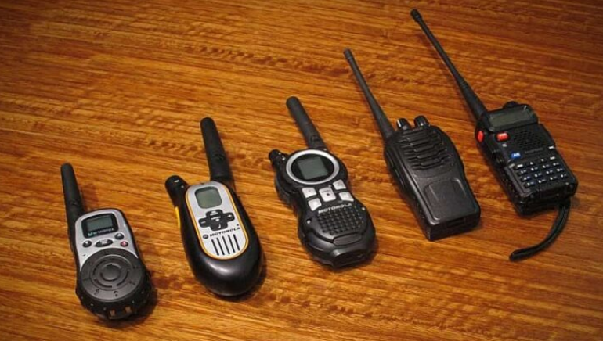
Henryk Magnuski
Henryk was the chief designer of the first portable radio (walkie-talkie).
While working for Motorola he designed a motorola SCR - 300 (The world's first backpack radio with a manually selectable FM frequency[1] was designed during World War II. The radio was widely used by American forces in Europe and during the Pacific battles against the Japanese, popularly known as the walkie-talkie.)

Slide 9
Thank you for your attention.
Kacper Szestowicki

