Slide 1
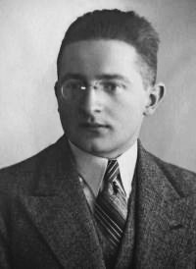
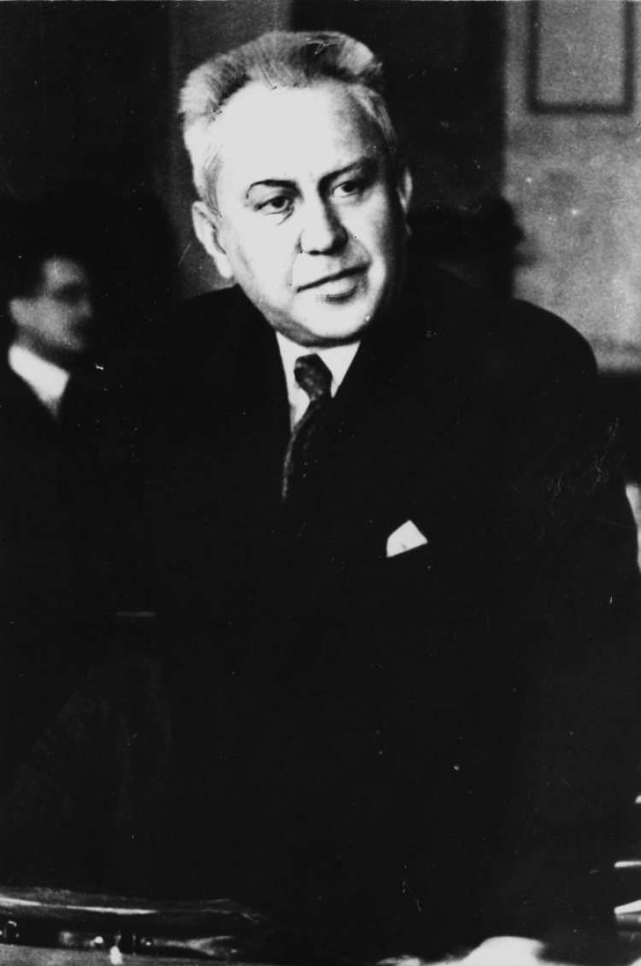
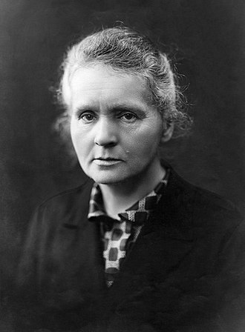
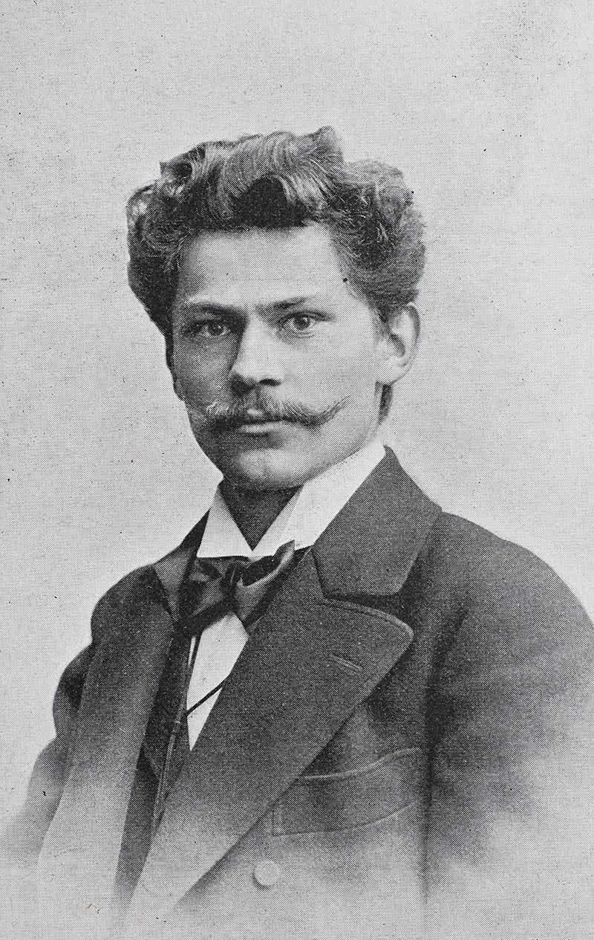
Outstanding Polish inventions that changed the world

Slide 2
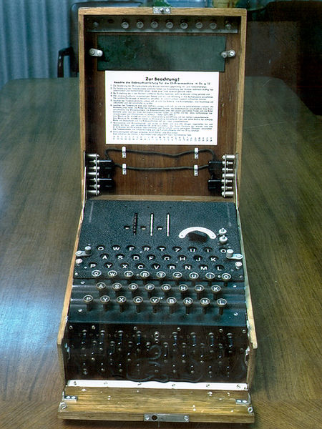
Marian Rejewski was a Polish mathematician and cryptologist. In 1932 he broke the secret code of the Enigma machine. Enigma was used to send secret messages during World War II. His work helped save many lives and end the war faster.
This is an Enigma machine.
➔

Slide 3
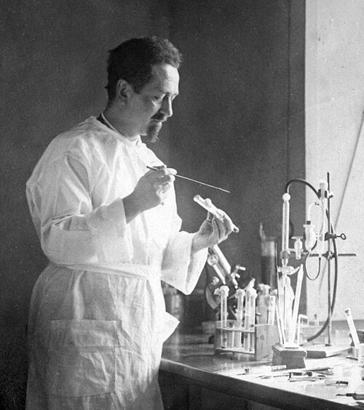
Rudolf Weigl was a Polish biologist.
He studied typhus and worked on how the disease spreads.
He created a vaccine to stop the illness.

Slide 4
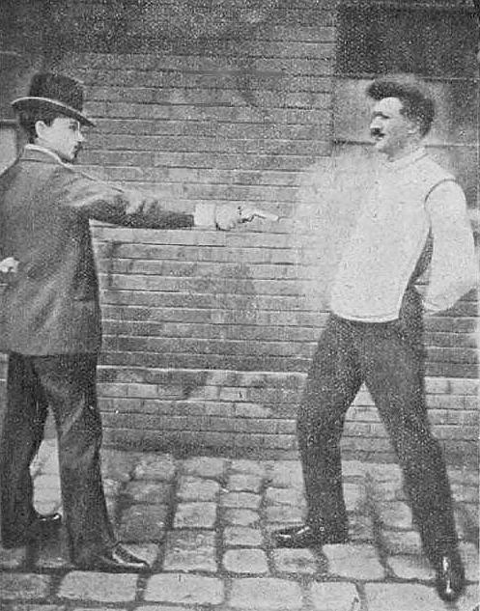
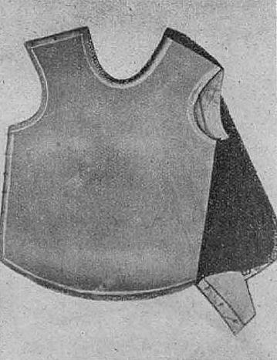
Jan Szczepanik was a Polish inventor. He created an early bulletproof vest. It once saved the life of the King of Spain. He also worked on early color photography and film inventions.

Slide 5
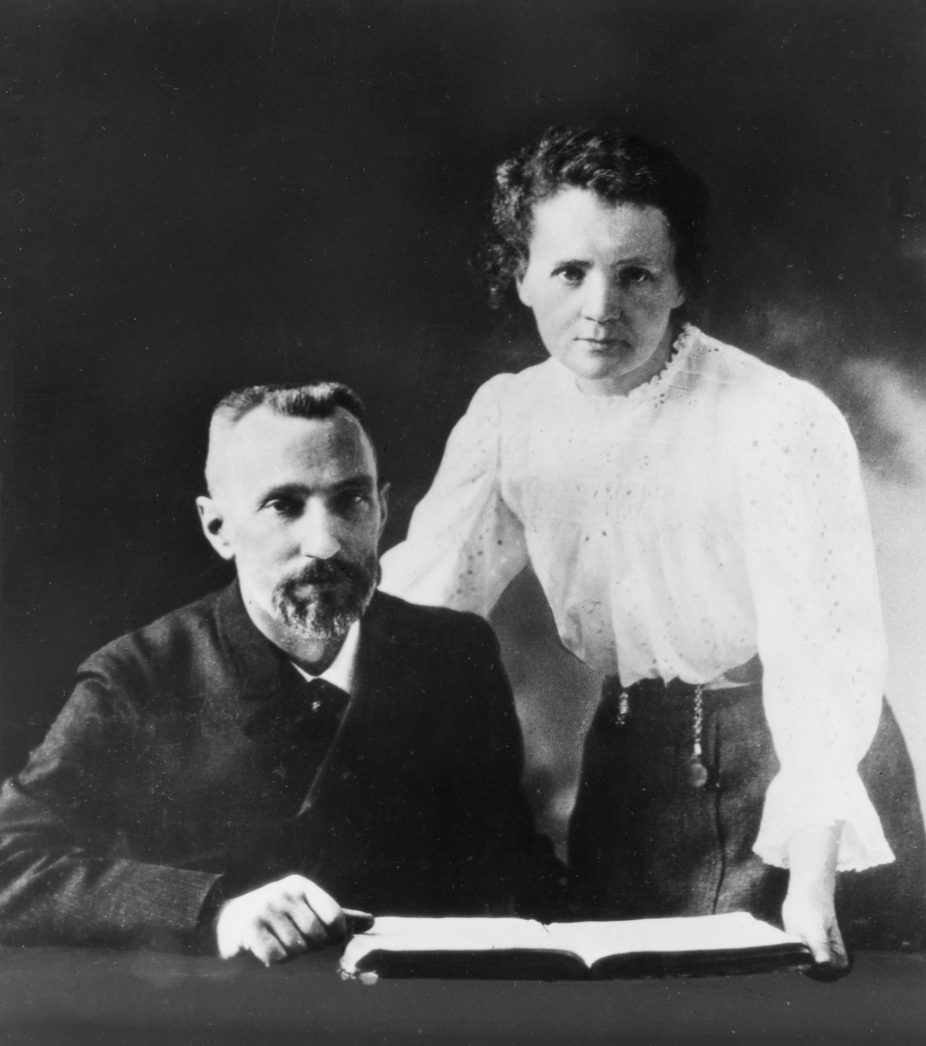
Maria Skłodowska-Curie was a Polish scientist. She discovered two new elements: polonium and radium. She studied radioactivity and won two Nobel Prizes.
Pierre Curie was a French scientist and Maria’s husband. They worked together on the study of radioactivity.

Slide 6
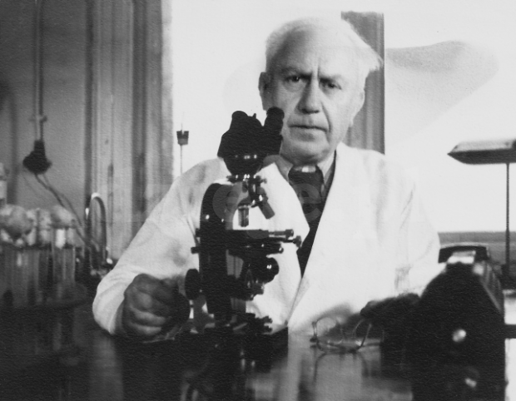
Ludwik Hirszfeld was a Polish scientist and doctor. He studied blood and discovered the system of blood groups: A, B, AB, and O. His work is very important for doctors today, especially for safe blood transfusions.

Slide 7
Science is everywhere, and Poland has always been part of it - so be proud to be Polish!
Paweł Niewiński 7A

