Slide 1

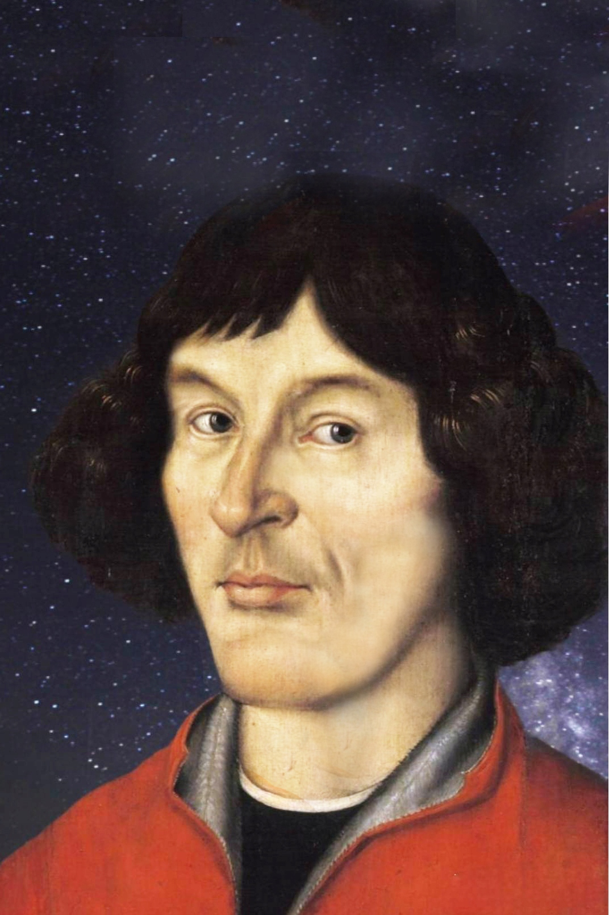
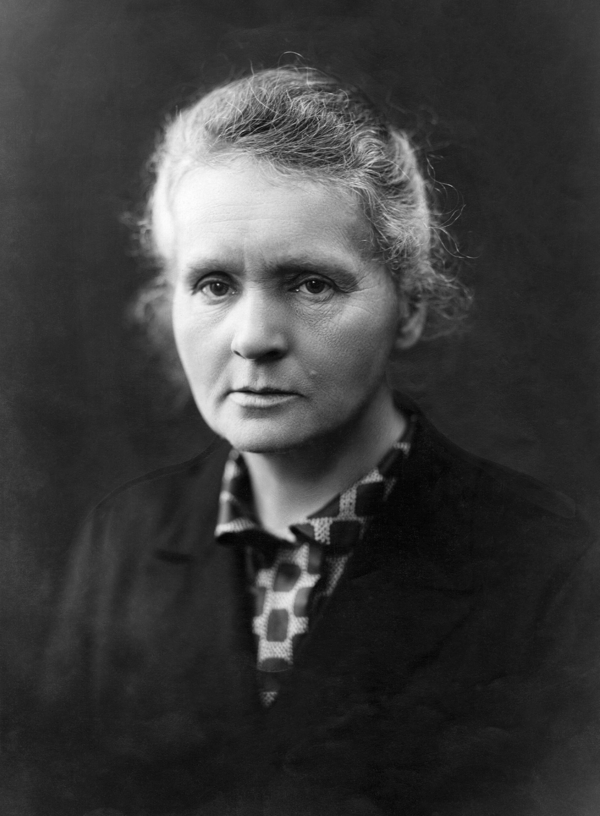
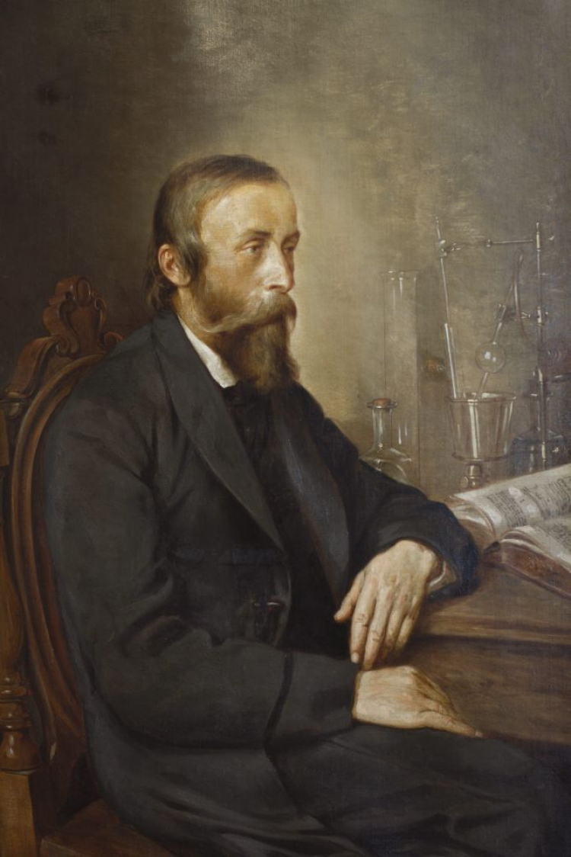
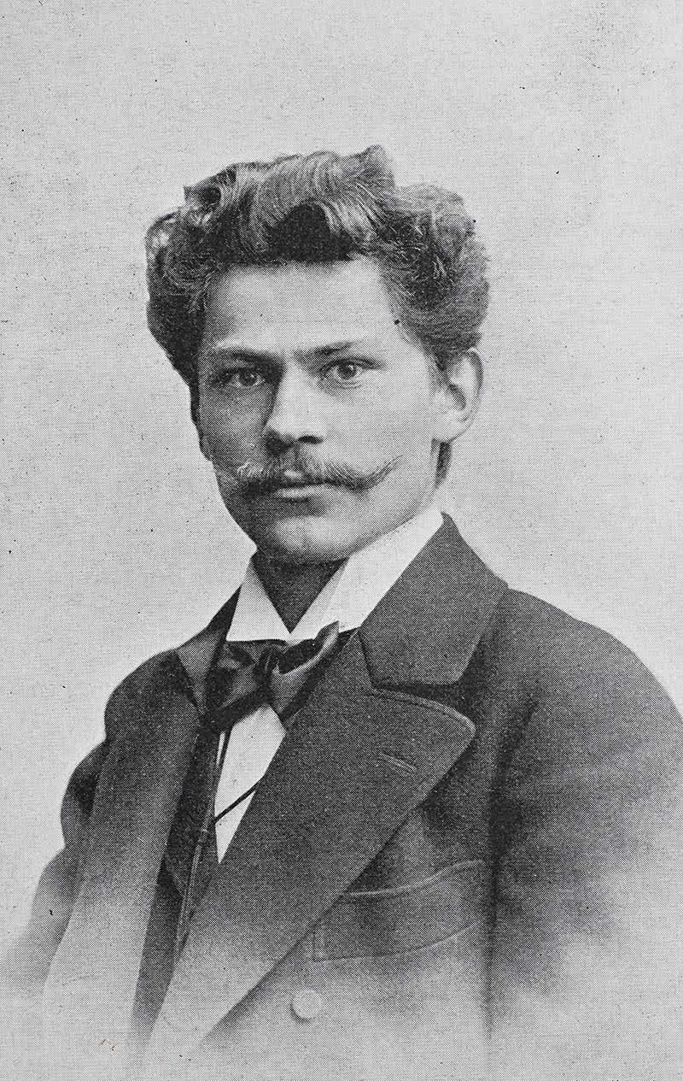
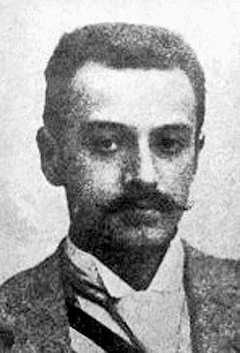
Polish scientists and their achievements

Slide 2
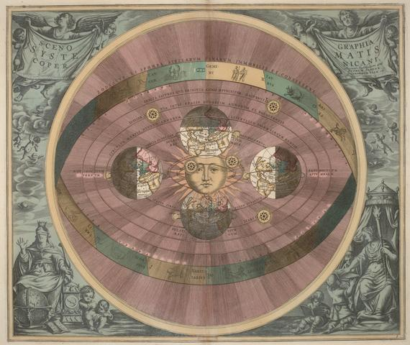
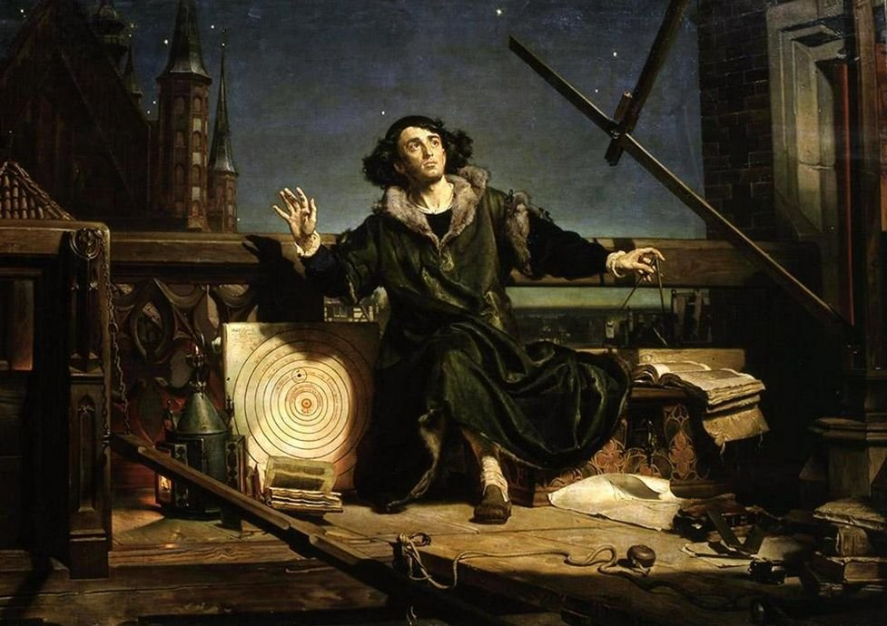
Nicolaus Copernicus
He was a polish astronomer born in Toruń in 1473. Copernicus studied mathematics and astronomy in Kraków and later in Italy. He is known for creating the heliocentric theory which says that the Earth moves around the Sun. His ideas changed the way people understood the universe.

Slide 3
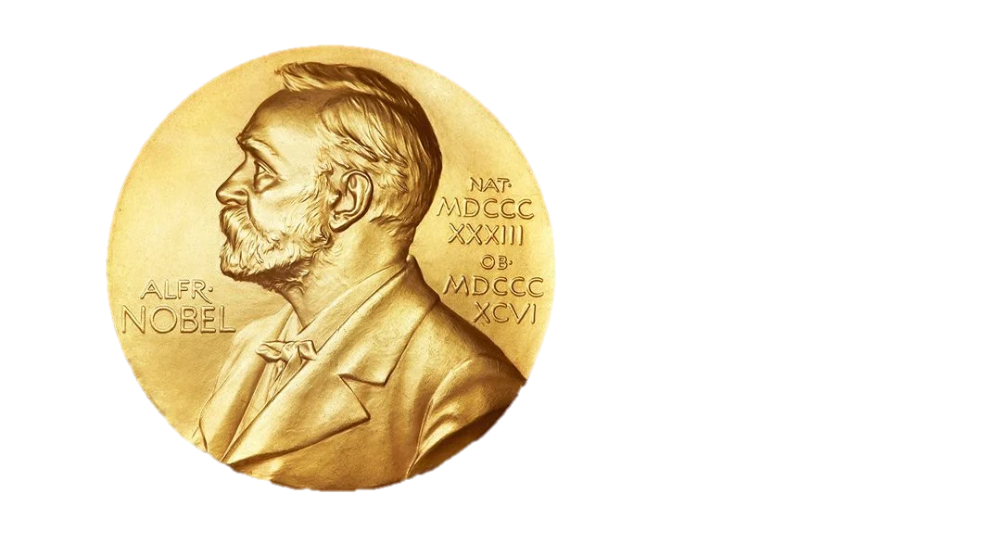
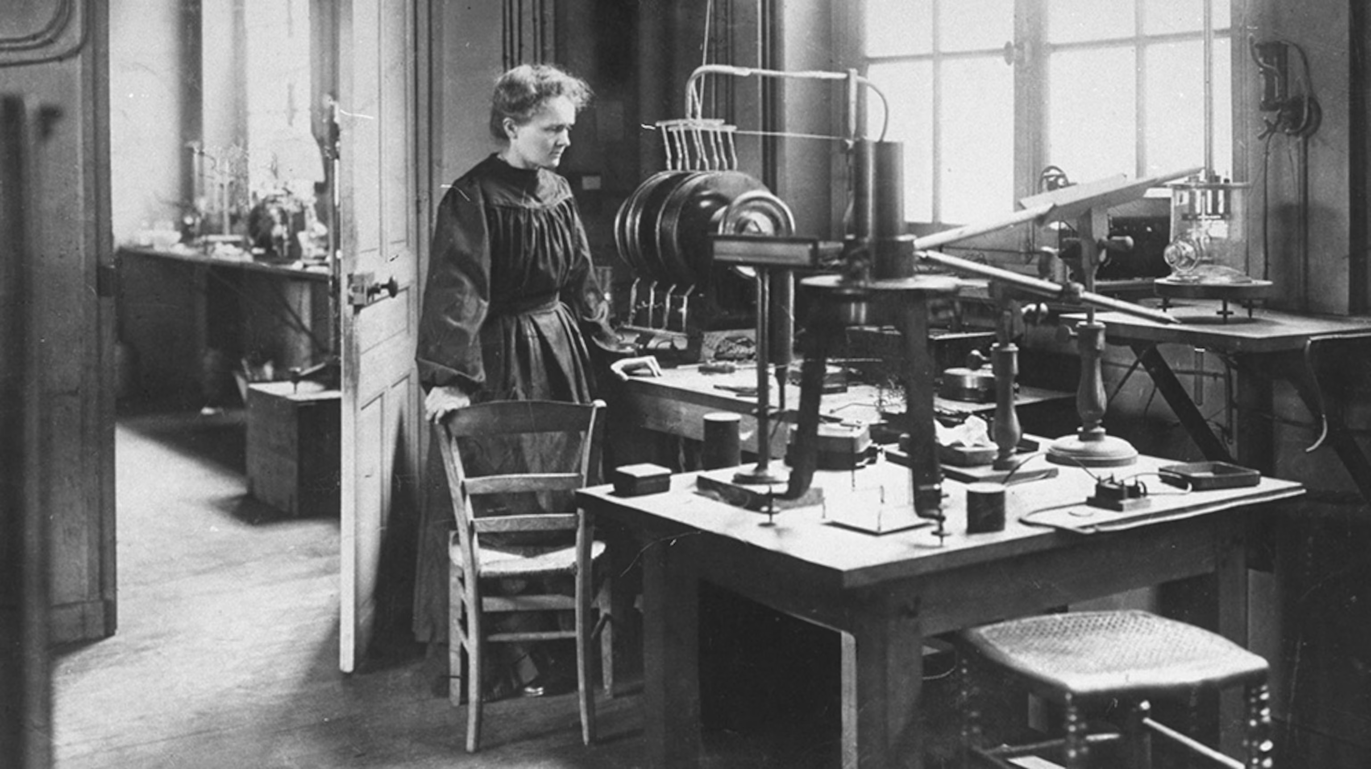

Marie Skłodowska Curie
She was a polish scientist born in Warsaw in 1967. Marie studied in Poland and later in France. She was the only woman in her science class. Curie discovered two elements: polonium and radium. She was also the first person in history to receive two Nobel Prizes, one in Physics and one in Chemistry. Her discoveries changed science and medicine.

Slide 4
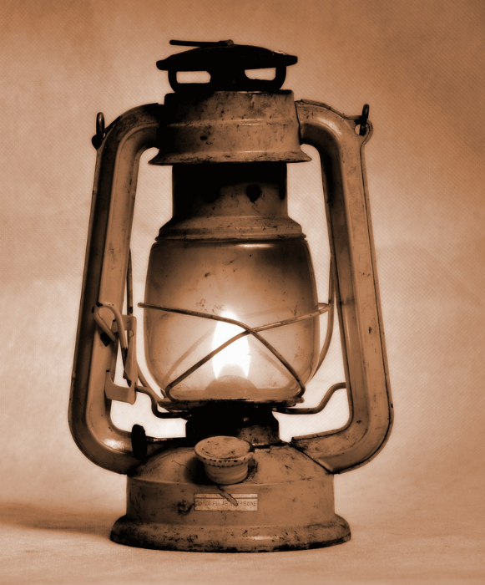
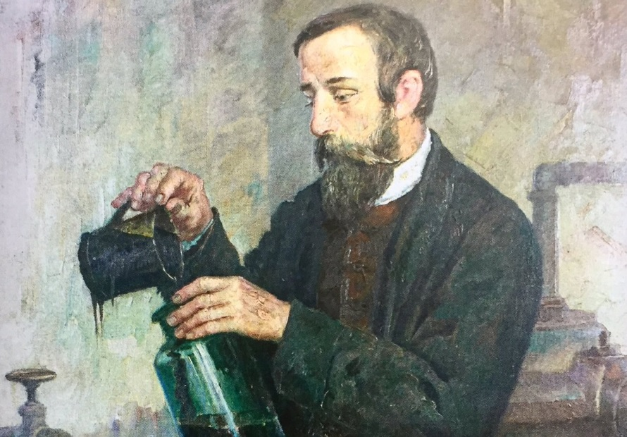
Ignacy Łukasiewicz
He was a Polish chemist and inventor born in Zaduszniki in 1822. He studied pharmacy and chemistry in Poland and later Austria. Łukasiewicz was the first person to create and invent the kerosene lamp. He also helped to develop the oil industry. His invention and work changed energy use and made lighting safer and better.

Slide 5
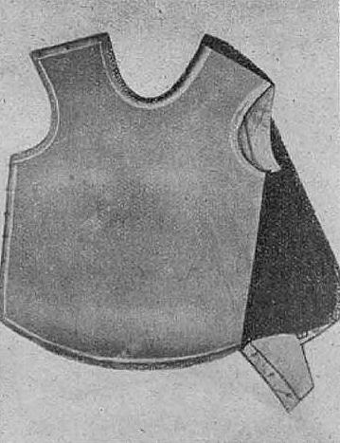
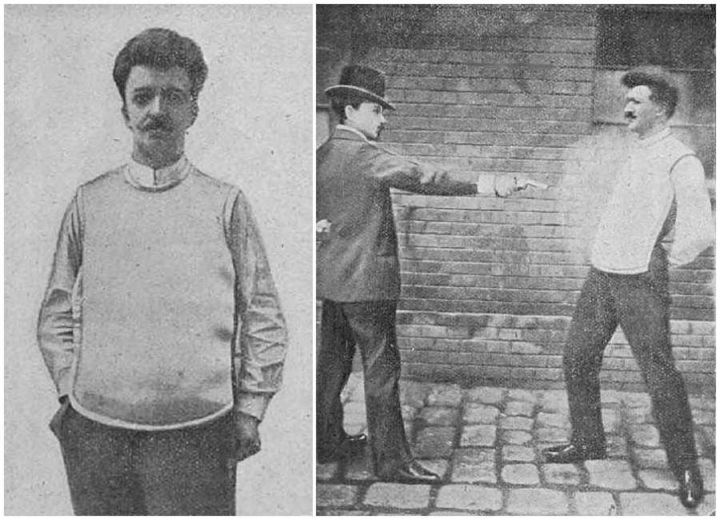
Jan Szczepanik
He was a Polish inventor born in Rudniki in 1872. He studied engineering and mechanics in Poland and abroad. Szczepanik created and invented the bulletproof vest using special materials. He also invented a method for color photography and improved movie projectors. Jan was also sometimes called the „Polish Edison” because of his inventions. His work changed the way people could watch or take pictures and films.

Slide 6
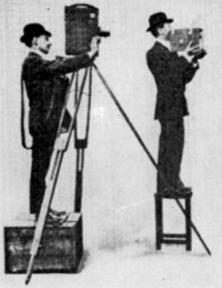
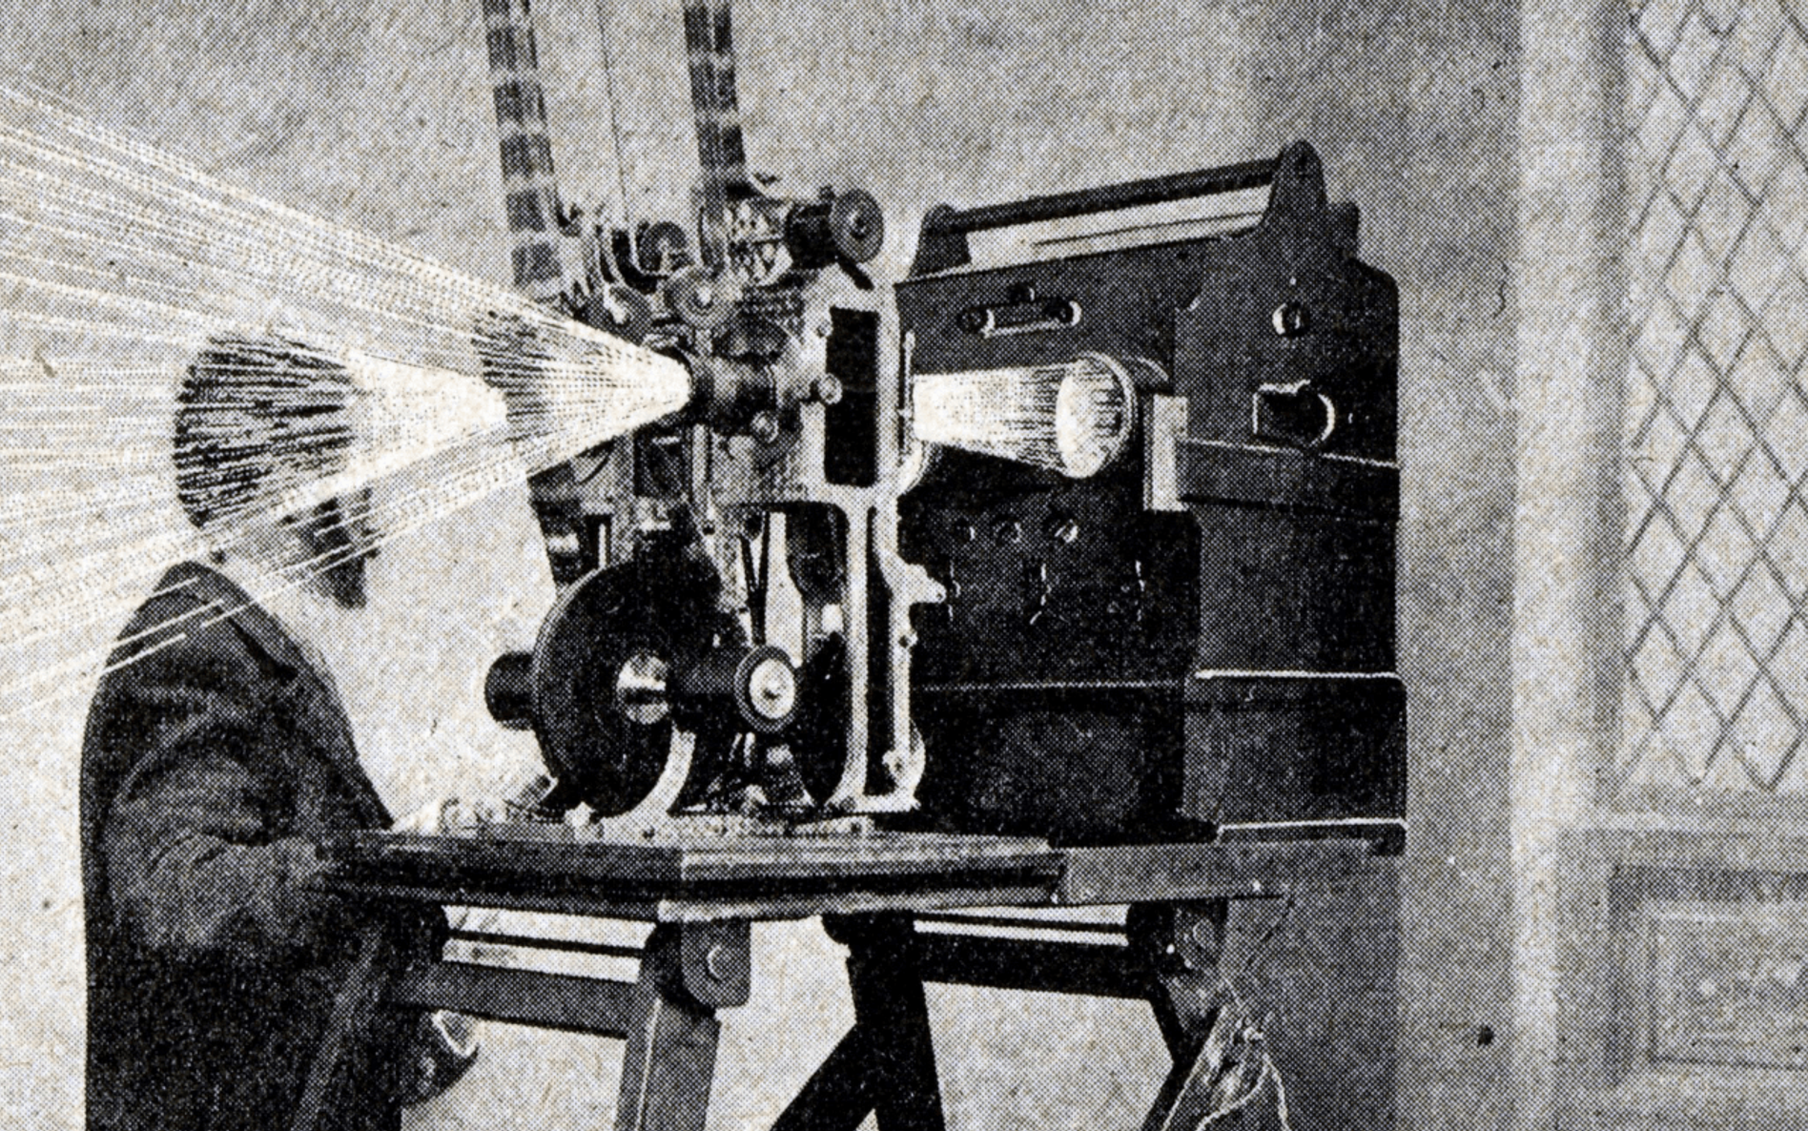
Kazimierz Prószyński
He was a Polish inventor born in Warsaw in 1875. He studied film and photography in Poland. Prószyński invented the first hand-held camera called the pleograph. He also created new methods to improve film recording and projection. His work improved the way people could make and watch videos.

Slide 7
Thanks for your attention :D

