Slide 1
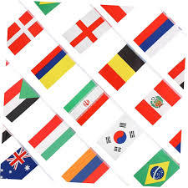
Global Citizenship
Global citizenship is the understanding that one's identity and responsibilities extend beyond national borders to encompass the entire human community and the planet.

Slide 2
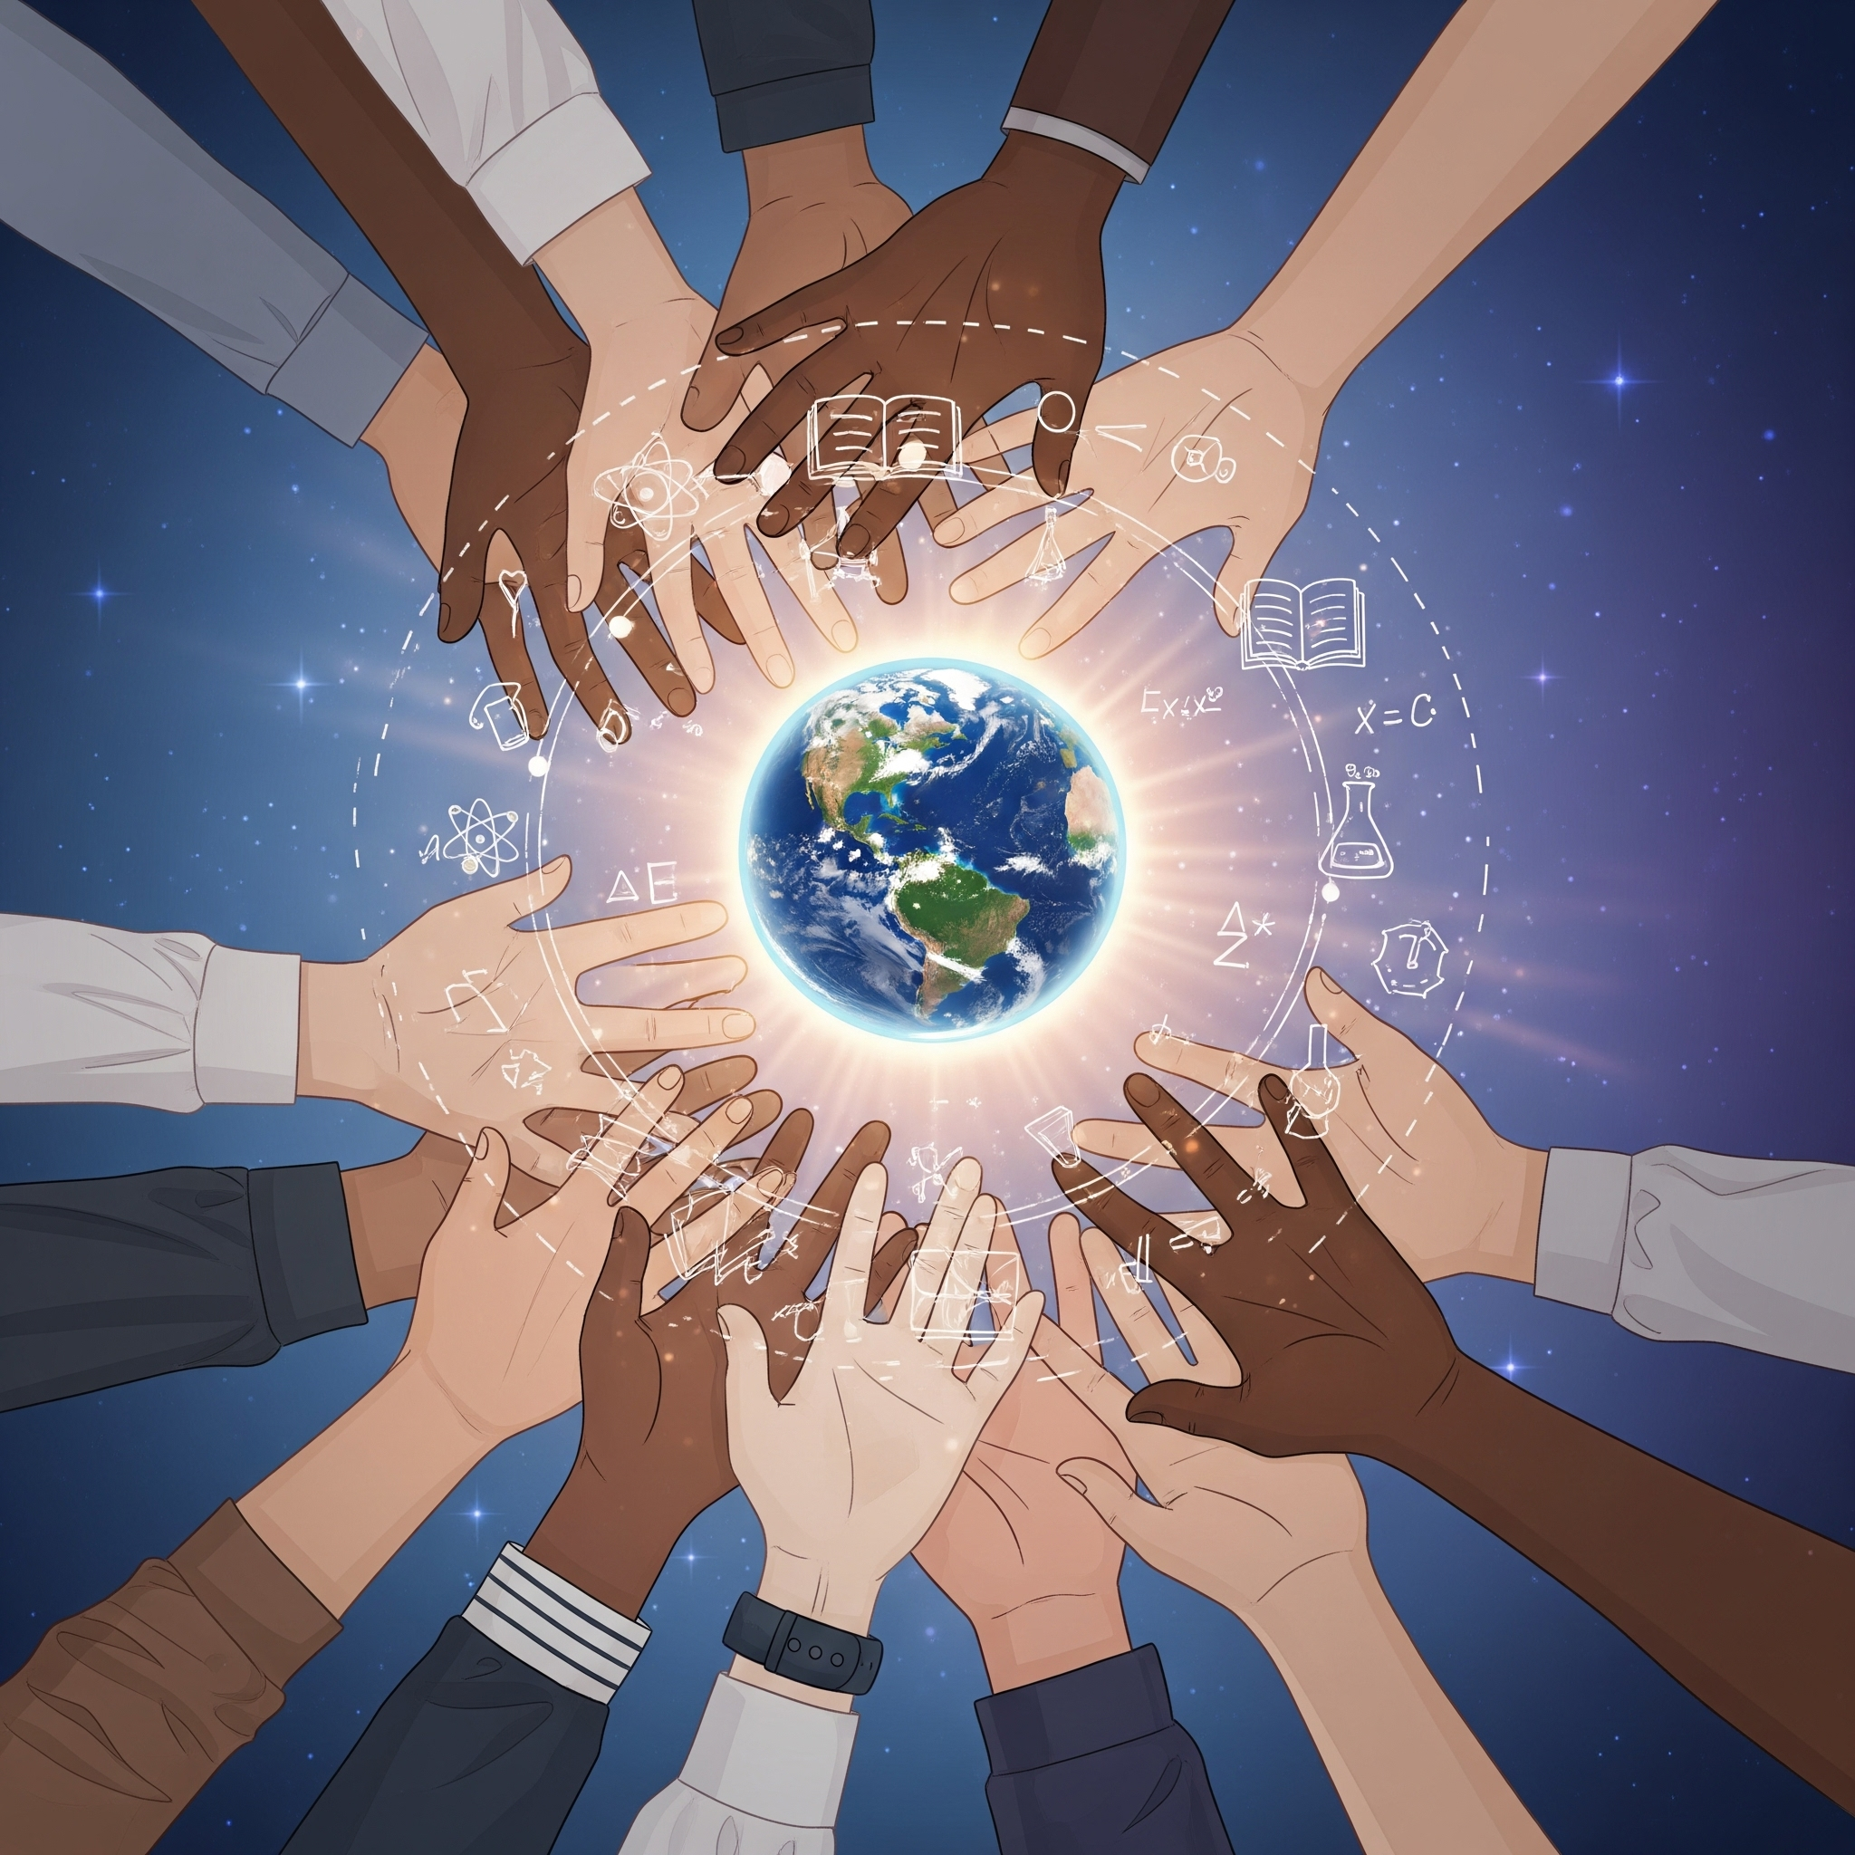
How to become a global citizen?
Educate yourself about global issues and world cultures
Develop respect for diversity and other perspectives
Engage in volunteering and activities for the planet
Choose responsible consumption and support fair trade
Follow current world events and be aware

Slide 3
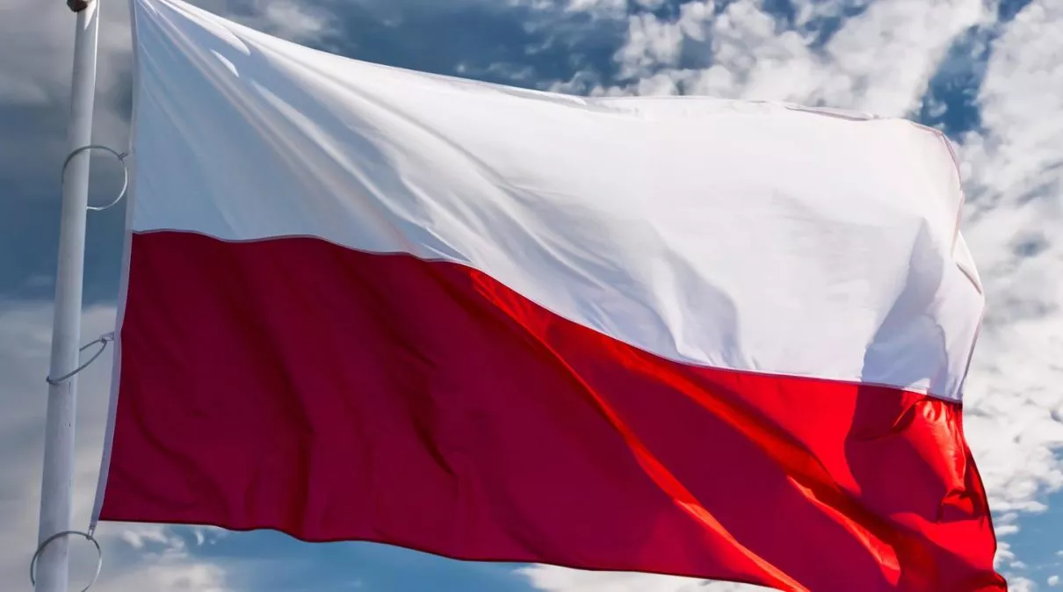
Globalization and Me: My Role in the Global Community.
MY CONNECTION:
I am simultaneously a citizen of a country (Poland) and the world.
My choices (e.g., what I buy, what I eat) connect me with people on every continent.
Global problems (like climate change) are my problems.
MY RESPONSIBILITY:
Understand: Learn about other cultures and global challenges.
Respect: Act with empathy and tolerance toward diversity.
Act: Implement small, sustainable changes in your daily life.

Slide 4
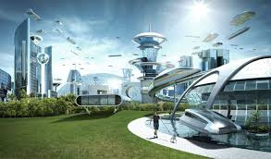
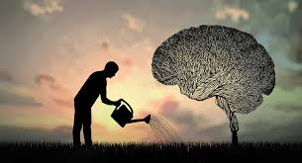
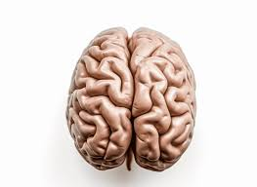
A Global Citizen attitude develops:
Intercultural empathy
Critical thinking and openness
The ability to cooperate in a diverse environment

Slide 5
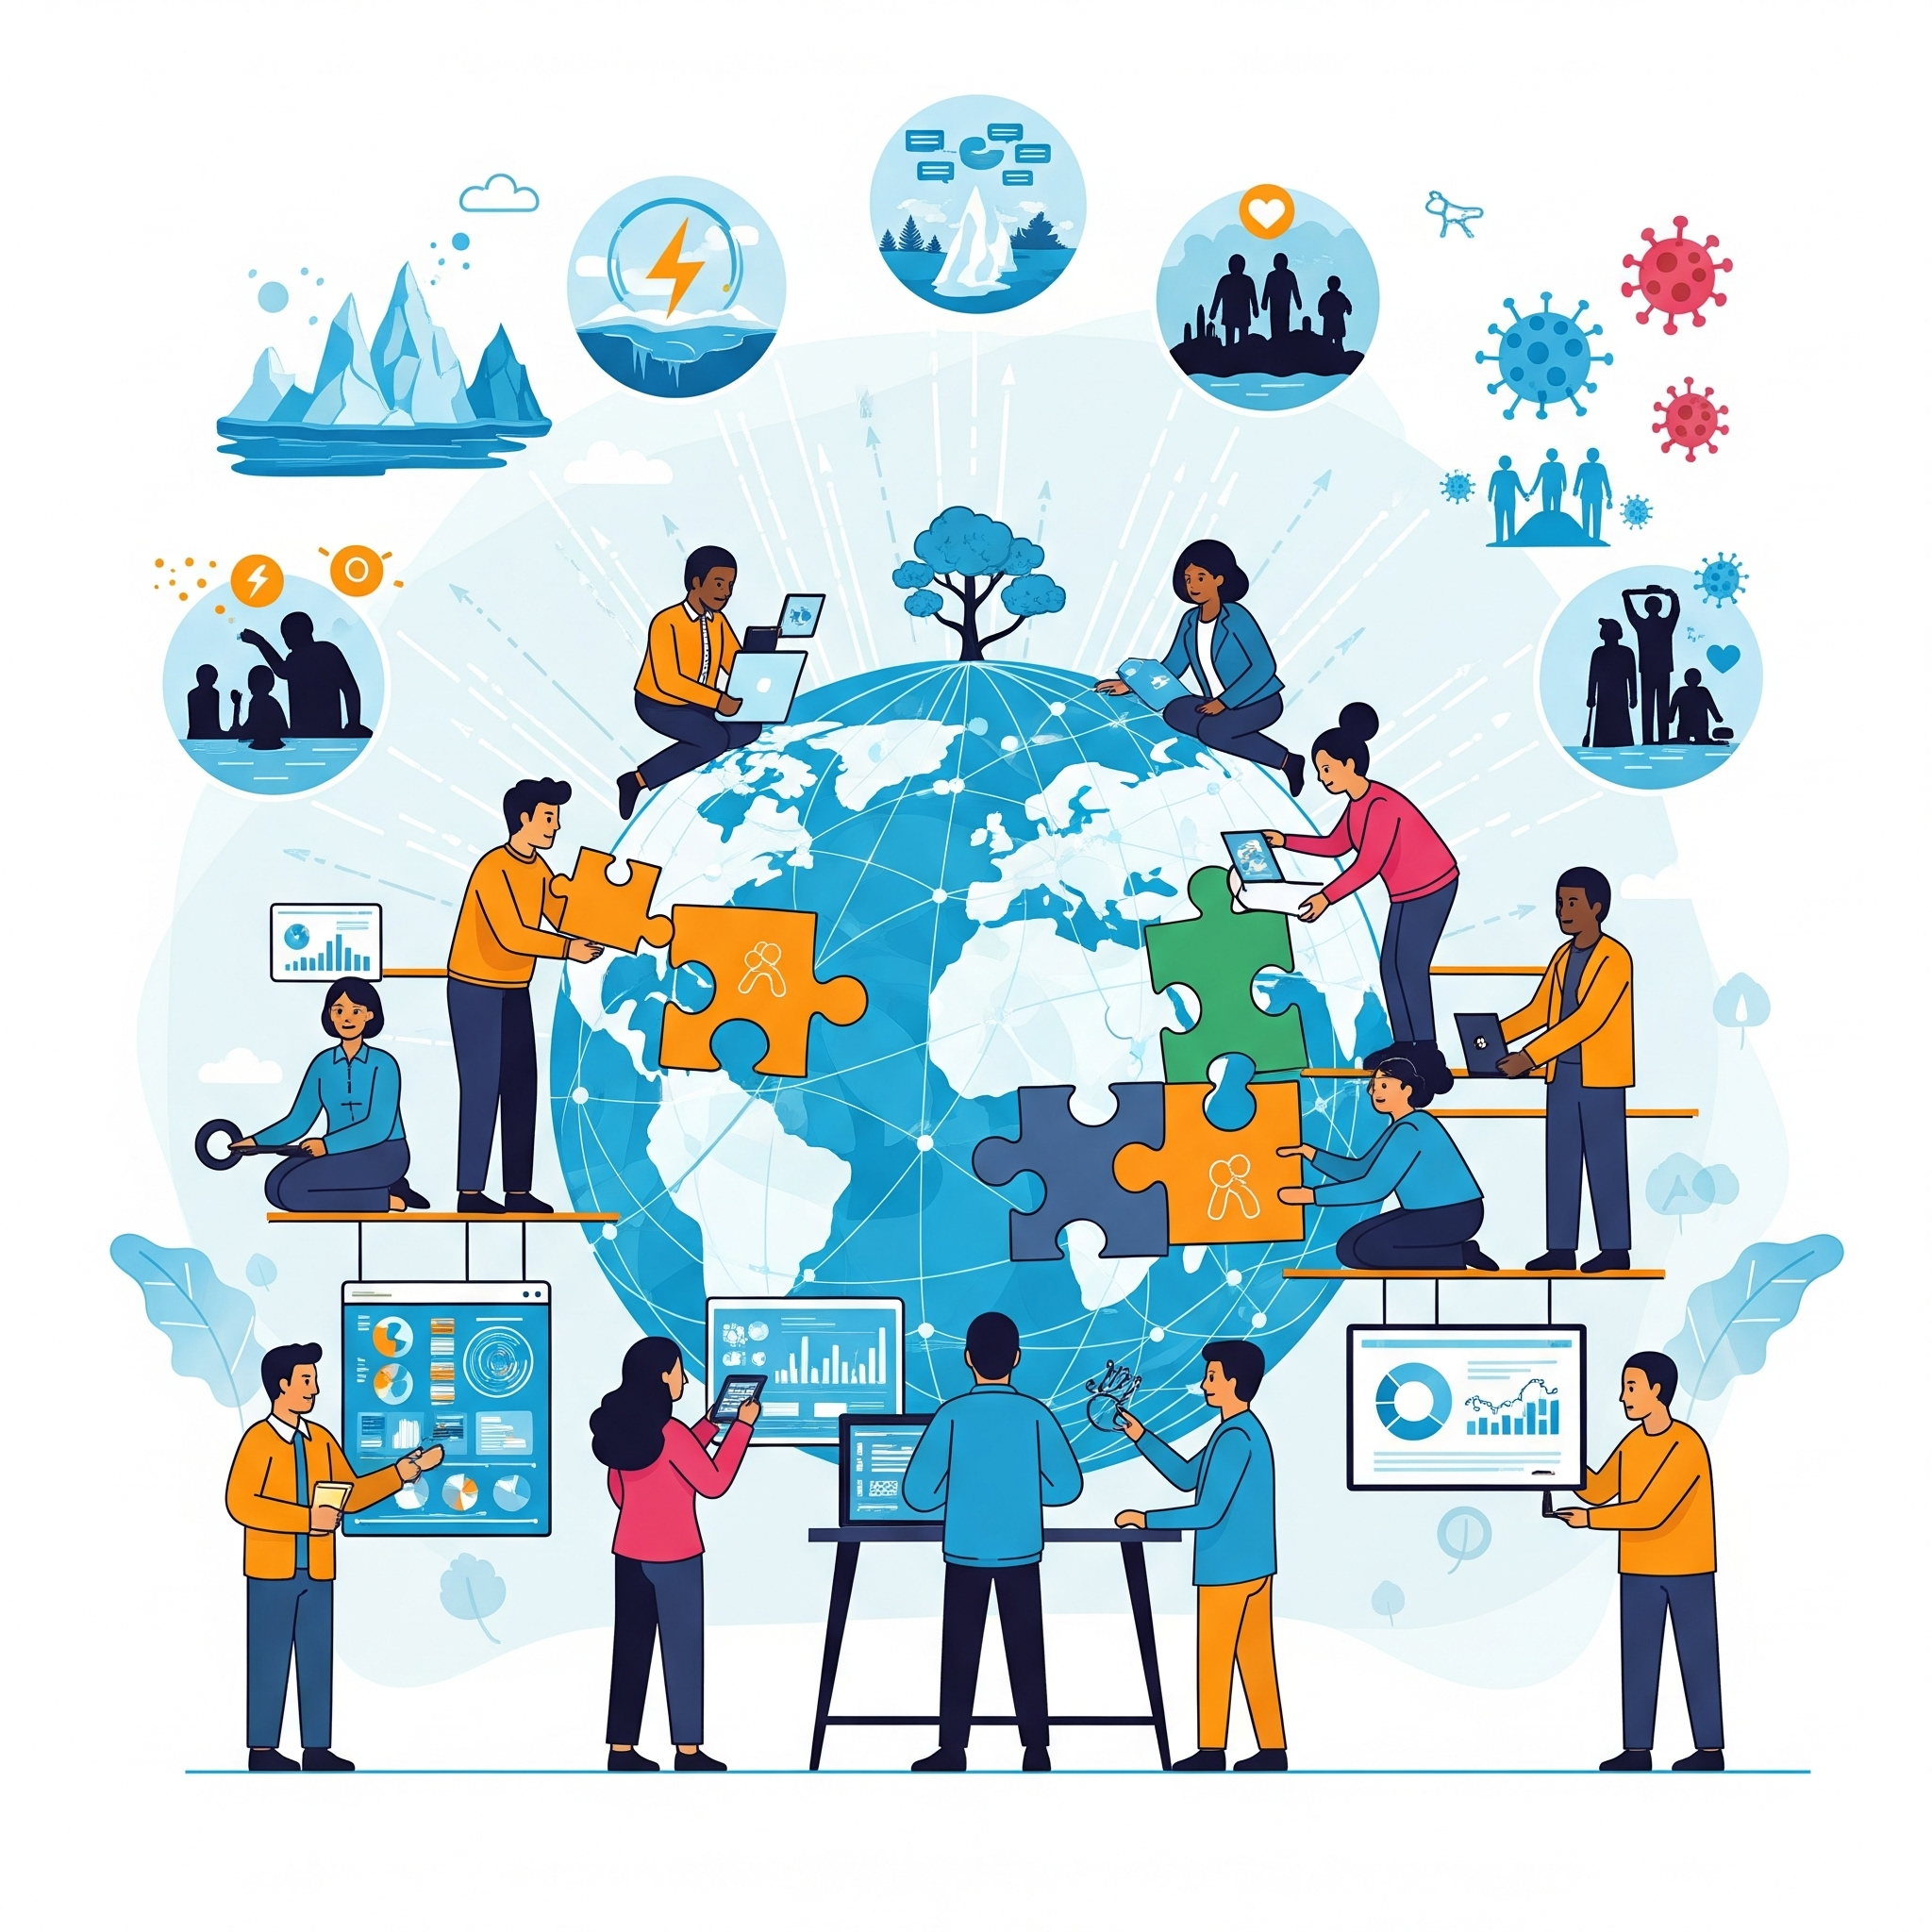
Who is a global citizen?
A global citizen is a world-aware person
Understands global problems and acts responsibly
Engages in creating a better, sustainable future
Accepts and respects the diversity of other cultures

Slide 6
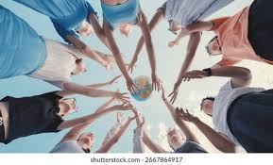
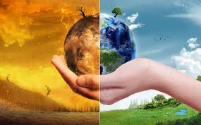
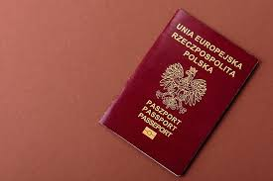
🌍 What does global citizenship mean?
Awareness: Understanding global problems, such as climate change, poverty, inequality, human rights, or cultural diversity.
Responsibility: Noticing that our actions influence the world – socially, economically, and environmentally.
Engagement: Participation in actions for sustainable development, peace, and justice – locally and globally.
Respect: Appreciating and accepting diverse cultures, perspectives, and ways of life.

Slide 7
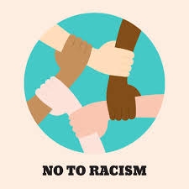
🧭 Examples of global citizenship in practice
Choosing fair trade products and responsible consumption
Actions for climate protection
Local or international volunteering
Fighting discrimination
Consciously following world events

Slide 8
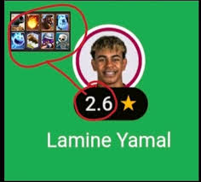
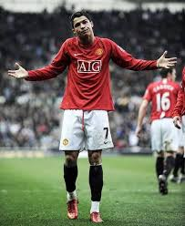
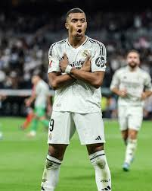
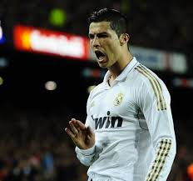
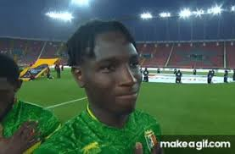
🌍 Sport connects people from all over the world
Wiele inicjatyw sportowych promuje pokój i zrozumienie między narodami. Wspólne treningi, programy dla młodzieży czy międzynarodowe wydarzenia sportowe wspierają dialog i redukują napięcia społeczne
.
Wielu sportowców angażuje się w akcje humanitarne, kampanie ekologiczne i edukacyjne.
W ten sposób promują globalną odpowiedzialność i inspirują innych do działania.

Slide 9
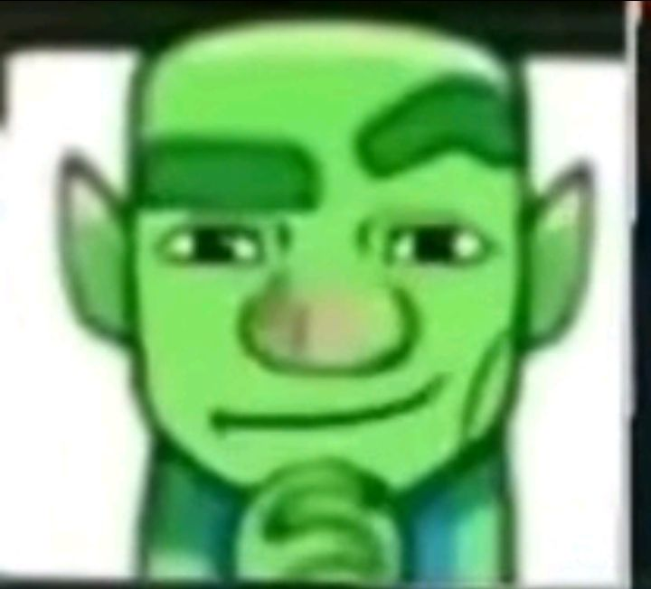
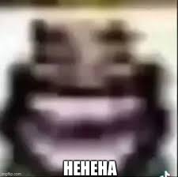
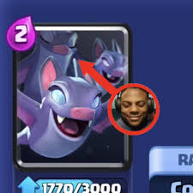
🌍Clash Royale and global citizenship🌍
A game that connects players from all over the world
Clash Royale is a global community — players from different countries compete and cooperate in the same environment. This shows that the digital world can connect people across borders, similar to the idea of global citizenship.
🧠 2. Respect and fair play
Clash Royale is a competition, but based on the principles of fair play. The game culture teaches respect for the opponent, patience, and the ability to deal with defeat — these are important traits not only in games but also in the global community.

Slide 10


Examples of global citizens' actions
Wspieranie organizacji międzynarodowych (np. UNICEF, Greenpeace).
Udział w projektach ekologicznych i wolontariacie.
Edukacja międzykulturowa i przeciwdziałanie dyskryminacji.
Świadome wybory konsumenckie (eko-produkty).
Tworzenie lub wspieranie kampanii społecznych.

Slide 11
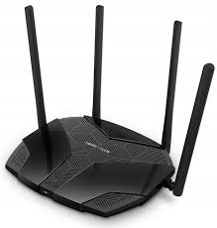








The role of technology in global citizenship
Internet ułatwia dostęp do informacji i edukacji.
Media społecznościowe pozwalają organizować globalne akcje i protesty.
Technologia sprzyja współpracy międzynarodowej (projekty online, zdalne wolontariaty).
Jednocześnie wymaga świadomego korzystania — przeciwdziałania fake newsom i cyberprzemocy.

Slide 12
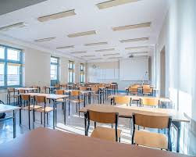
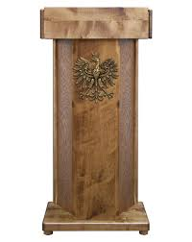
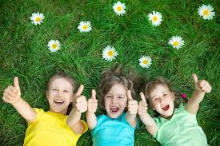

The future of global citizenship
Increasing role of digital and ecological education.
Migration and global connections will increase.
Growing importance of international cooperation.
The younger generation will be key in shaping global values and policies.

Slide 13
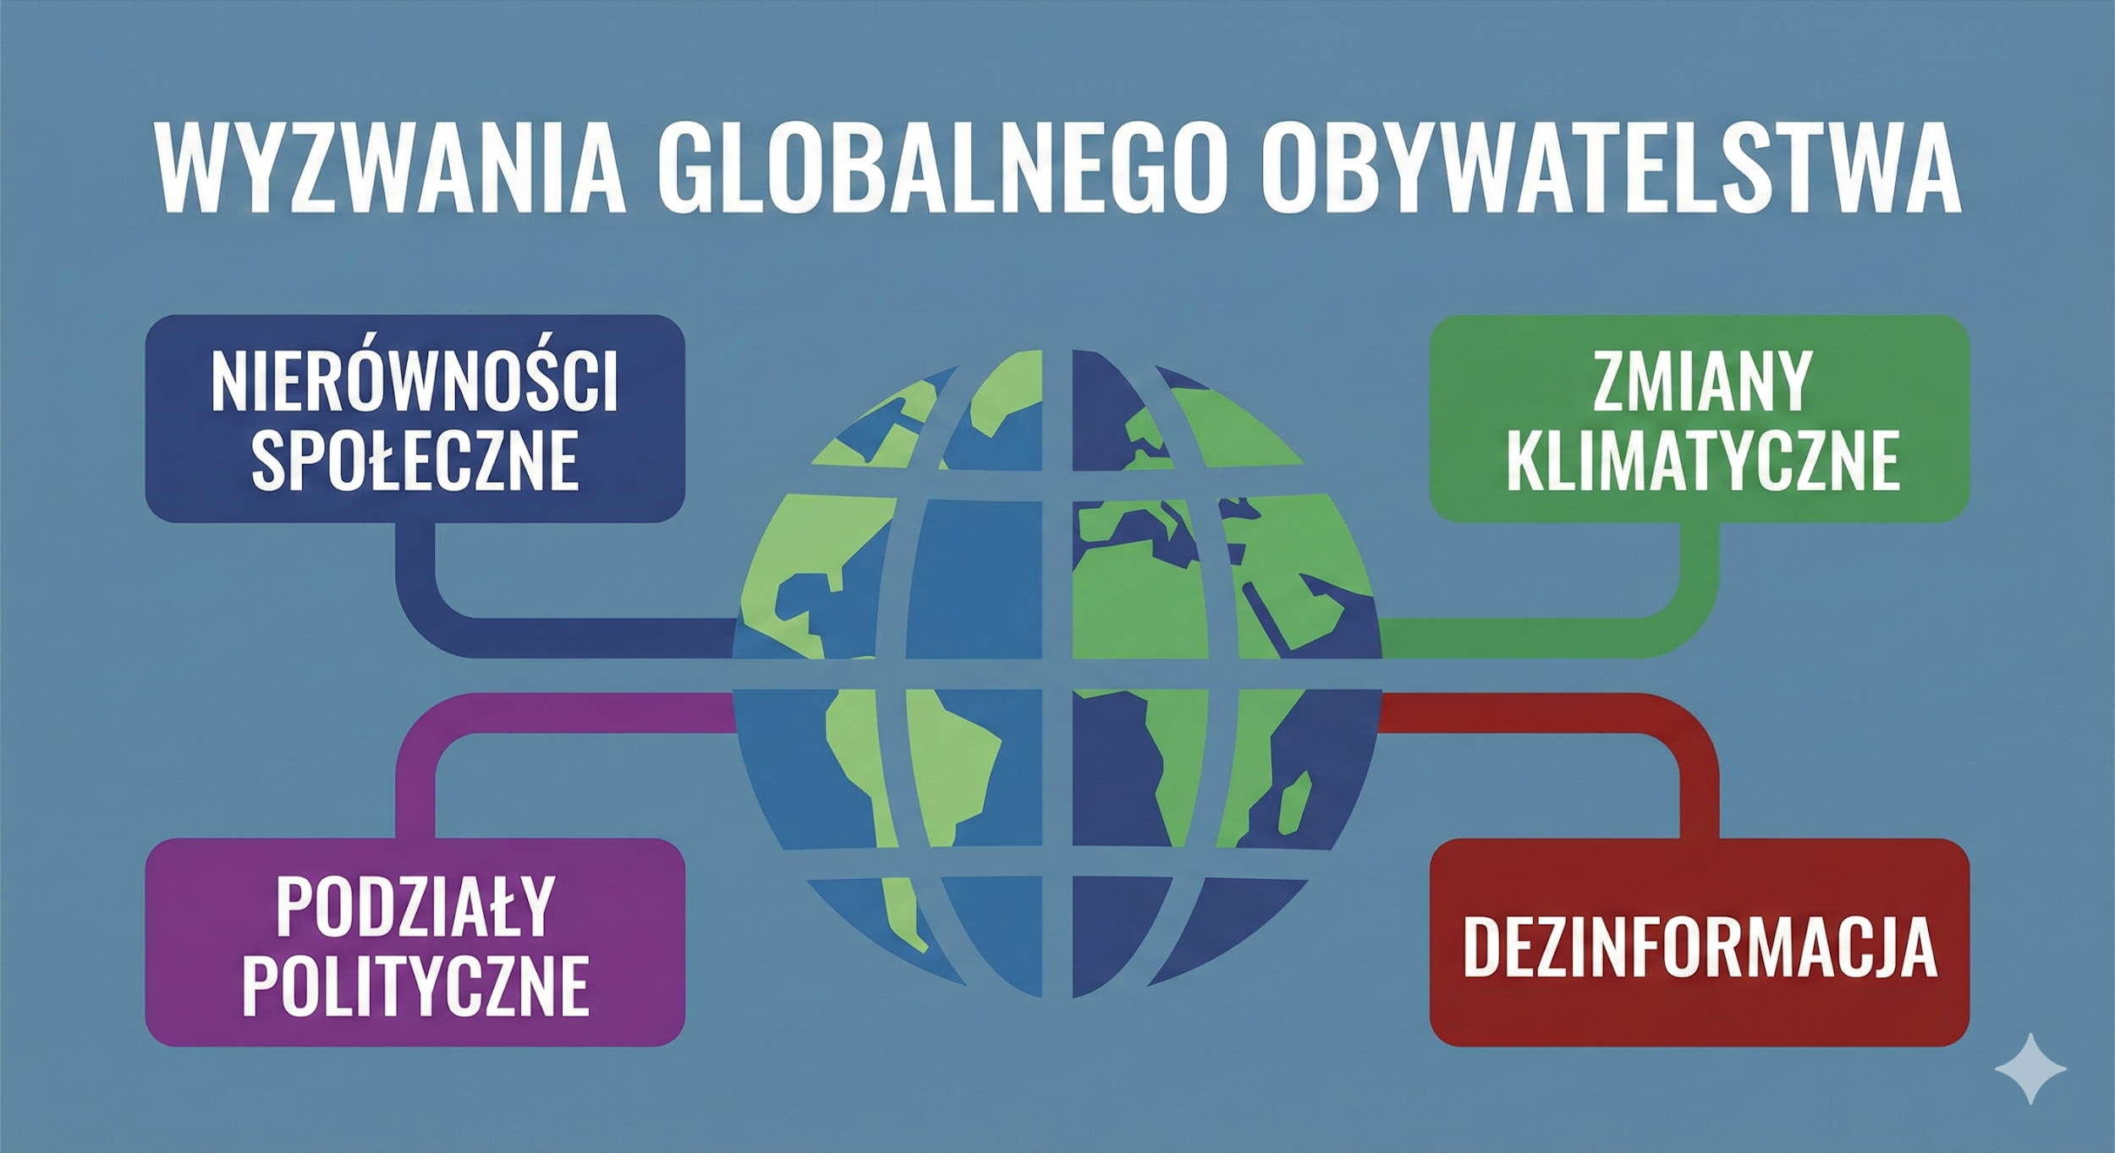



A
hubert to pała💣💣

Slide 14

Summary
Global citizenship is a conscious, responsible approach to the world.
Each of us has an impact on the global future.
Empathy, cooperation, and education are key.

Slide 15

Thank you for watching
Stworzone przez:
Szymon Czerwinski
Jan Kretowicz
Franciszek Kamiński
Bartosz Borkułak
Vladimir Cwirko
We hope we have encouraged you to implement at least some of the elements mentioned in this presentation and encourage you to try!
THANK YOU!!!
DZIĘKUJEMY !!!

