Slide 1
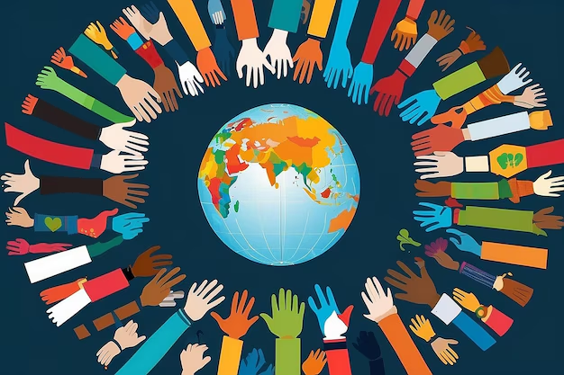
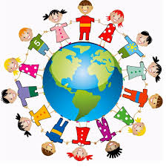
global citizenship

Slide 2


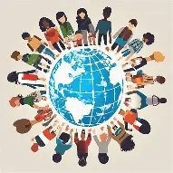
Global citizenship is the idea that one’s identity transcends geography or political borders and that responsibilities or right are derived from membership in a broader class of “humanity”.It does not mean a legal status like national citizenship,but rather a mindset and awareness.

Slide 3

KEY CONCEPTS :
> Interconnectedness: Understanding that local actions can have global consequences and that we are all linked socially,economically,and environmentally.
>Responsibility: A sense of duty to work towards a more peaceful, sustainable ,and fair world ,addressing issues like climate change and inequality.

Slide 4
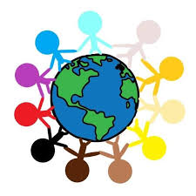
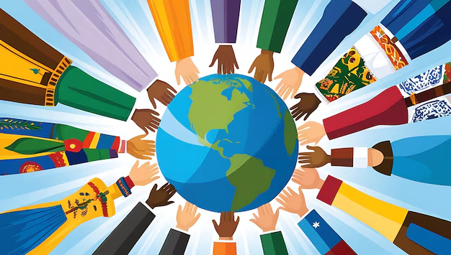
>Respect for Diversity:Valuing and respecting different cultures,perspectives,and backgrounds.
>Active Partition:Engaging in the community [locally or globally] to contribute to positive change.

Slide 5
EDUCATION AND ACTION
>Global Citizenship Education [GCED]:
Crucial for developing critical thinking and a sense of shared humanity . It teaches learns to understand global systems and their own place within them.
EXAMPLES IN ACTION:
>Particles in climate strikes,volunteering for international humanitarian aid ,advocating for human right online and offline,and practicing conscious consumerism [buying fair trade,reducing waste]

Slide 6

THANK YOU FOR WATCHING THE PRESENTATION!
DONE BY
HUBERT HAJDUKIEWICZ 7B

